Slide 1

TRAVEL BOOKING WEBSITE
Team C2:
Aditi 4SF21CS008
Diya Shetty 4SF21CS044
Misbah Zohar 4SF21CS084
Nihmat 4SF21CS099
Rithika 4SF21CS125

Slide 2
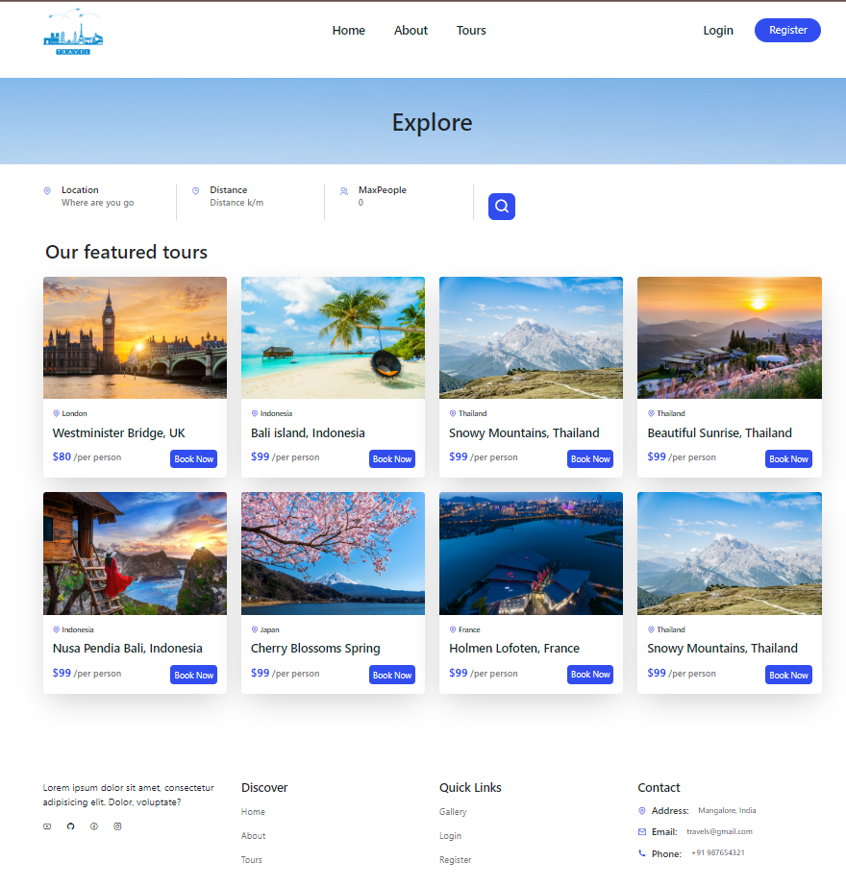
OBJECTIVE
It allows users to book tickets from this application. It’s easy to use platform , where user can book any tickets which will be stores in Database

Slide 3
TECHNICAL DETAILS
01
02
03
04
The front-end website is designed using HTML, CSS and JavaScript
The website is made flexible and responsive with the use of Bootstrap
The backend of the website is made using NodeJS, Express JS and Mongo dB
The website runs on HTTP Server

Slide 4





PAGES OF THE WEBSITE
HOME
ABOUT
TOURS
REGISTER
LOGIN

Slide 5
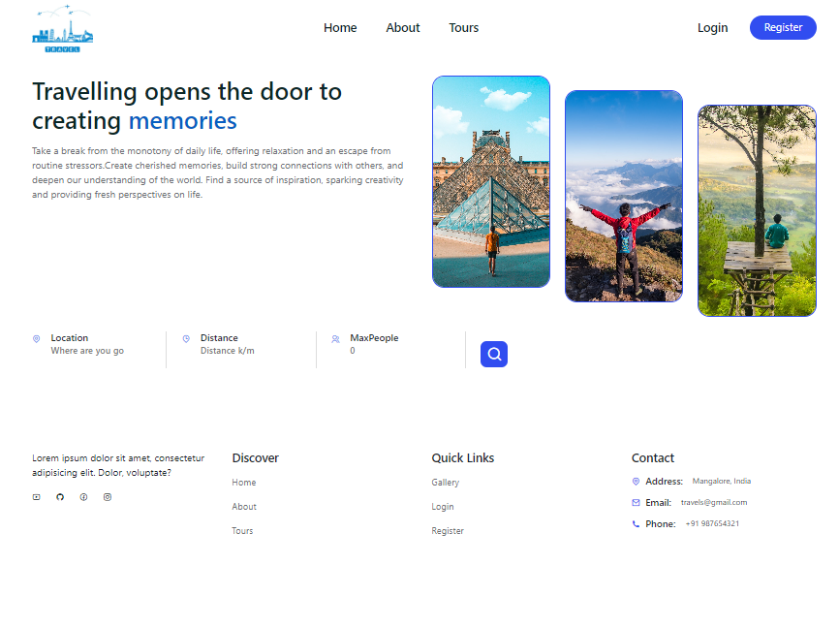
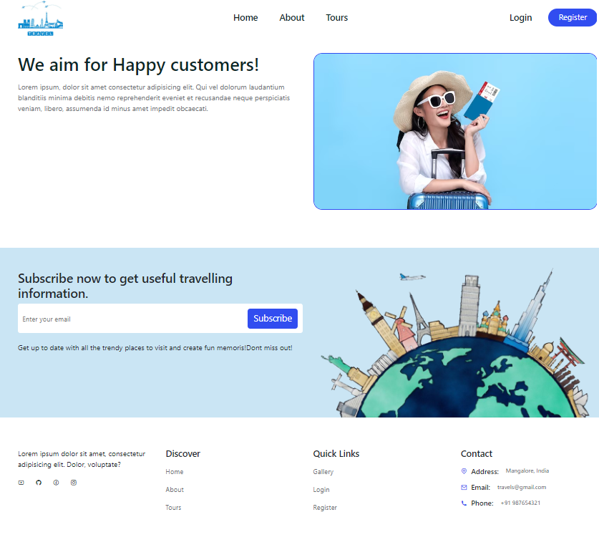
WEBSITE PAGES

Slide 6
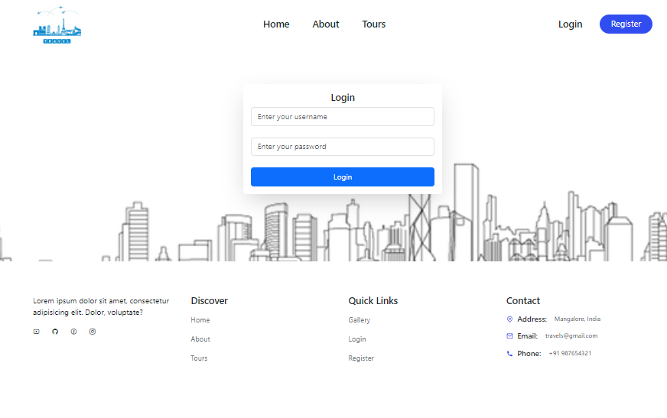
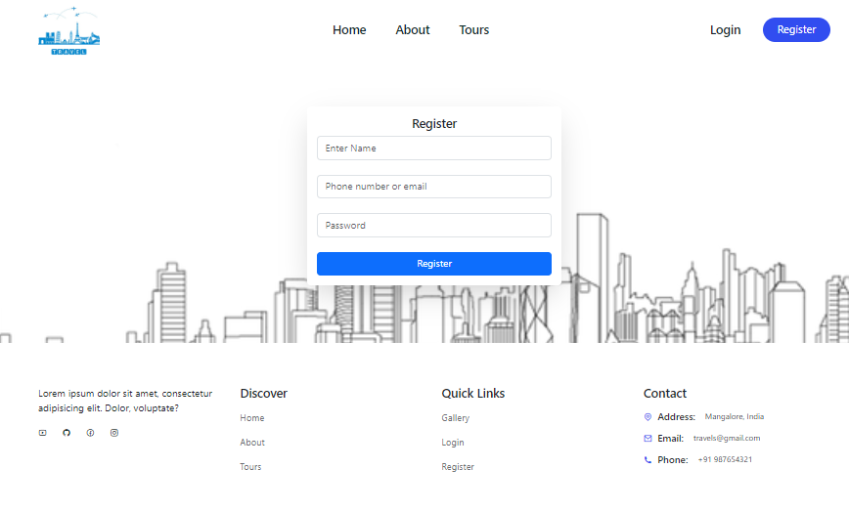
WEBSITE PAGES

Slide 7
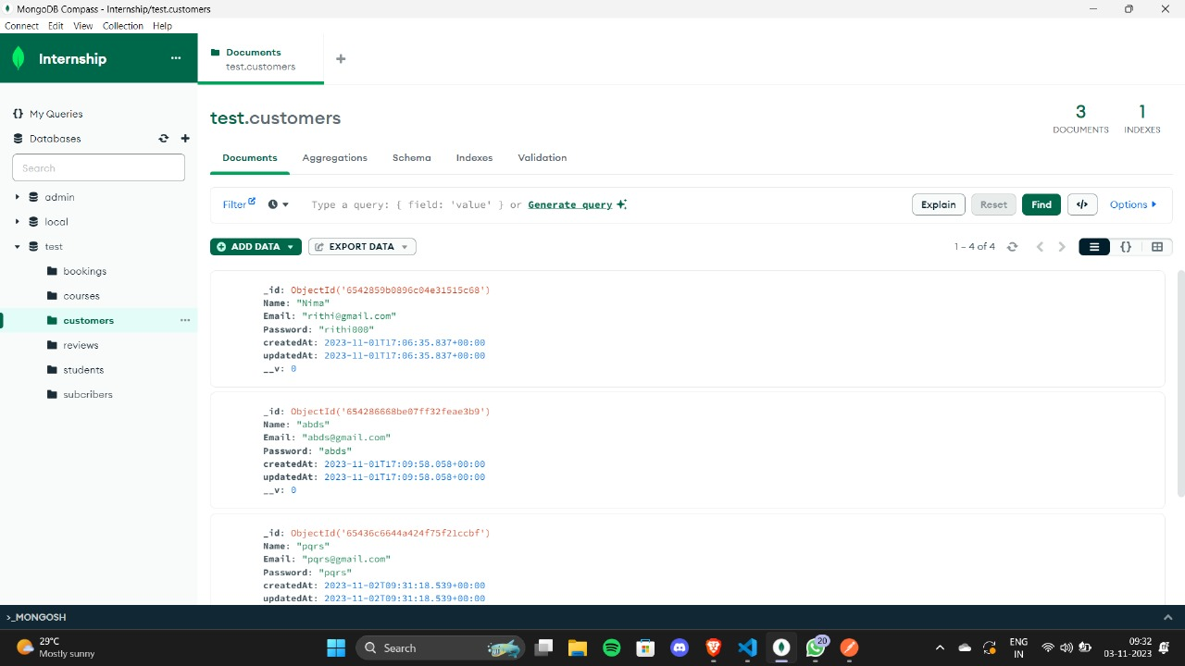
DATABASE

Slide 8

CONCLUSION
In this fast world people are busy with their work and they don’t want to waste time to book tickets offline, which is very time consuming. To overcome this problem we have made a Travel Booking website.
Our travel booking website is very user friendly and easy to use. It requires only few details to get and book tickets from our website.

Slide 9

THANK YOU

